Slide 1
Extended Leadership Workshop:
Identifying Efficiencies in Course Scheduling
February 20, 2026

Slide 2
Agenda
The path to competitive salaries for faculty and staff
Review of TWU’s current fiscal situation
Semester credit hours (SCH), formula funding and revenue generation
Choices for greater operational efficiency
Reducing our adjunct expenditures

Slide 3
The cost of salary growth
1% merit increase for all faculty and staff | $1.4 million
Market adjustment for all staff | ~ $2.4 million
Market adjustment for all faculty | ~ $3.0 million

Slide 4
How do we counter a reduction in
formula funding with our commitment
to invest in our people?

Slide 5
TWU’s current budget situation
A $3.65M decrease in formula funding each year of this biennium
State-mandated tuition/fees freeze

Slide 6
Common “levers” used to increase margin in higher ed
Grow enrollment
Cut/merge programs
Institute instructional efficiencies

Slide 7


Slide 8

The TWU Success Cycle
Higher Enrollment
per Section
Enhanced
Reputation
Greater SCH
Generation per FTF
Attract & Retain
Faculty & Staff
Reduced adjunct expenditures
More Resources for
Competitive Salaries

Slide 9
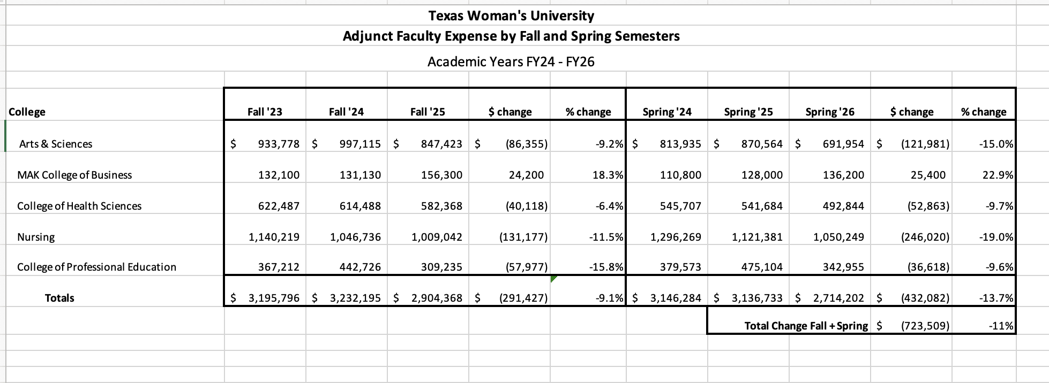

Slide 10
Foundational Budget Information

Slide 11
Does finance allocate too little of our university budget to Academic Affairs?

Slide 12
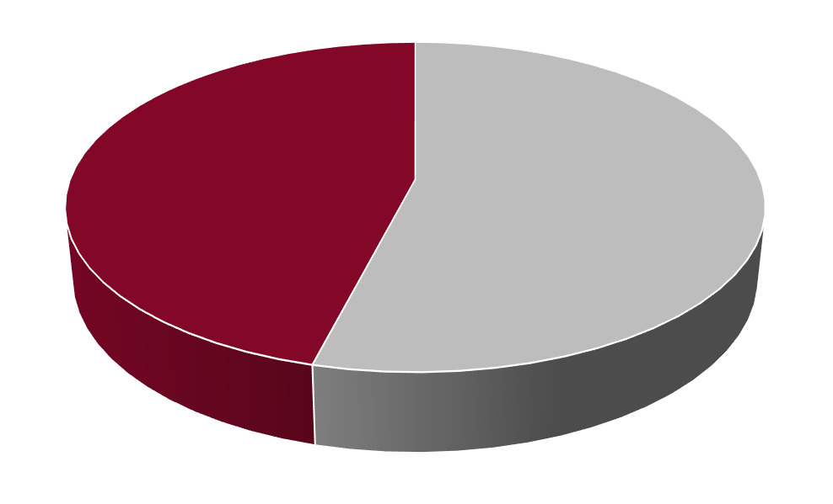
Instruction and Academic Support
as a percent of Total University Expenses
Top 15
Source: IPEDS Finance 2021-2023 (most recent 3 years)

Slide 13
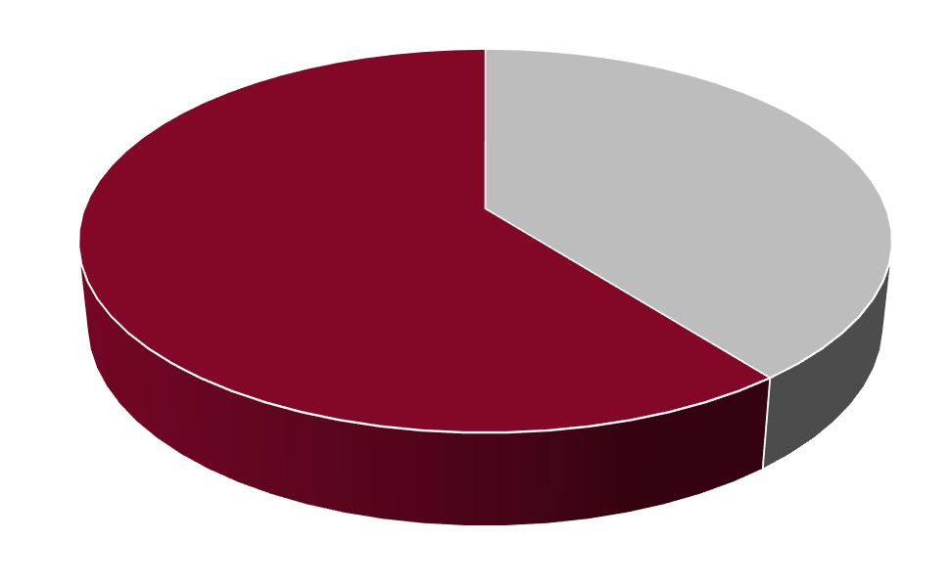
Instruction
as a percent of Total University Expenses
Top 15
Source: IPEDS Finance 2021-2023 (most recent 3 years)

Slide 14
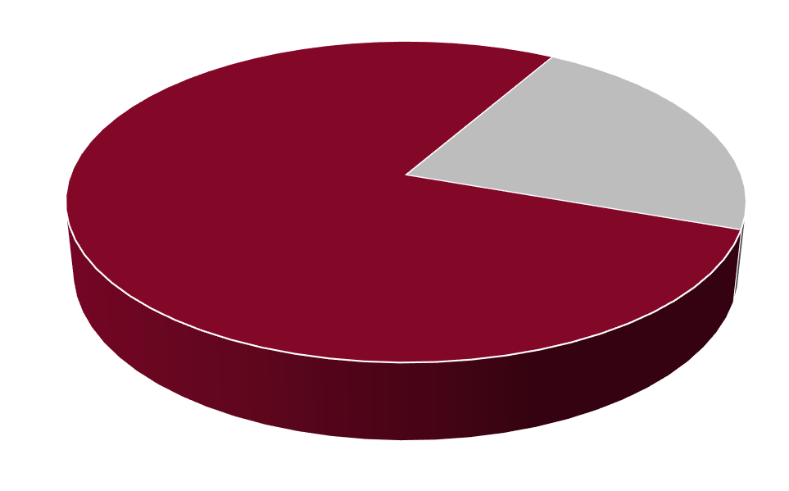
Instruction: Salaries and Wages
as a percent of Total University Expenses
Top 15
Source: IPEDS Finance 2021-2023 (most recent 3 years)

Slide 15
If Academic Affairs represents a large share of the university budget, why don’t we see stronger salary growth?

Slide 16
Key points re: faculty salaries
Largely paid with formula funding (“10 money”)
Based on SCH generation
Formula funding calculations:
  # of students enrolled X number of credits X multiplier provided by the state
Both course level and disciplinary area influence the size of the multiplier

Slide 18
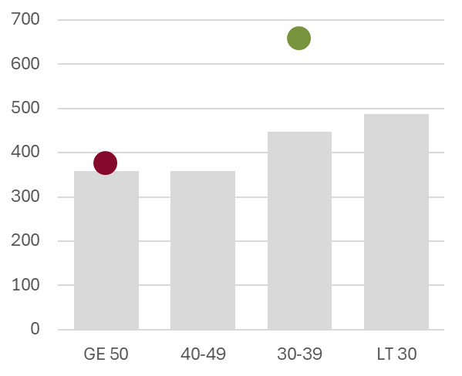
Semester Credit Hours
per Capita Instructional Staff
Part-time as % of Total Ins Staff
Sources: IPEDS 2021-2023 (most recent 3 years) and THECB Expenditure Study FY2024

Slide 19
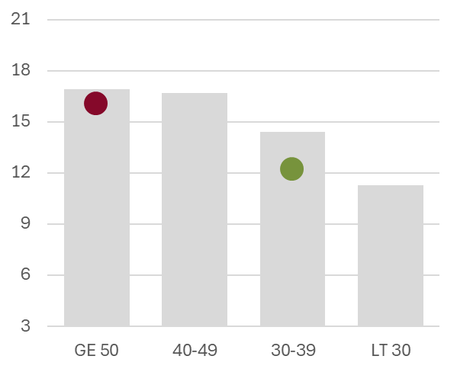
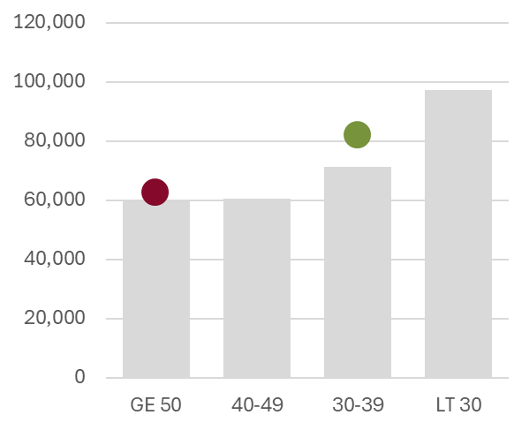
Instructional Staff
per $MM Salaries and Wages
Salaries and Wages
per Capita Instructional Staff
Part-time as % of Total Instr Staff
Part-time as % of Total Instr Staff
Sources: IPEDS Finance and Staff 2021-2023 (most recent 3 years)

Slide 20
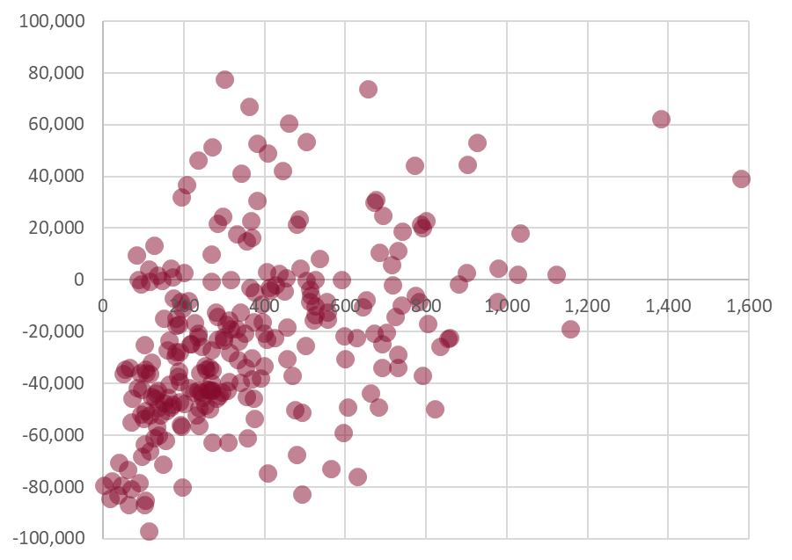
all Tenured and Tenure Track Faculty
Salary Coverage
formula funding minus salary
SCHs
Source: IRDM

Slide 21
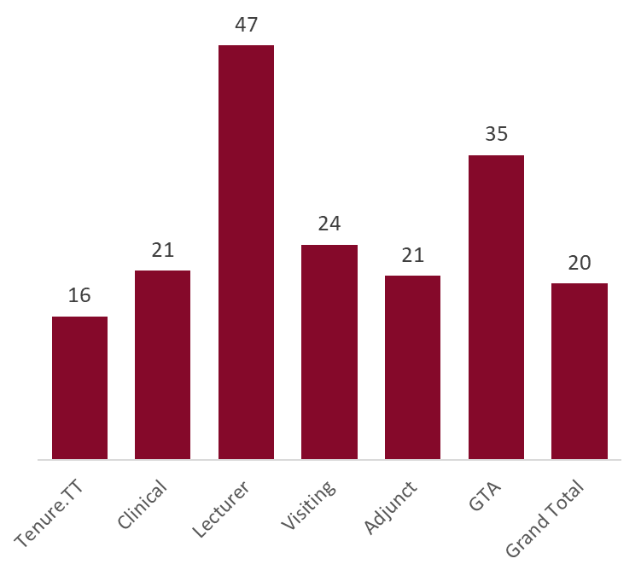
SCH per Credit Hour
by Faculty Type AY24-25
Source: IRDM

Slide 22
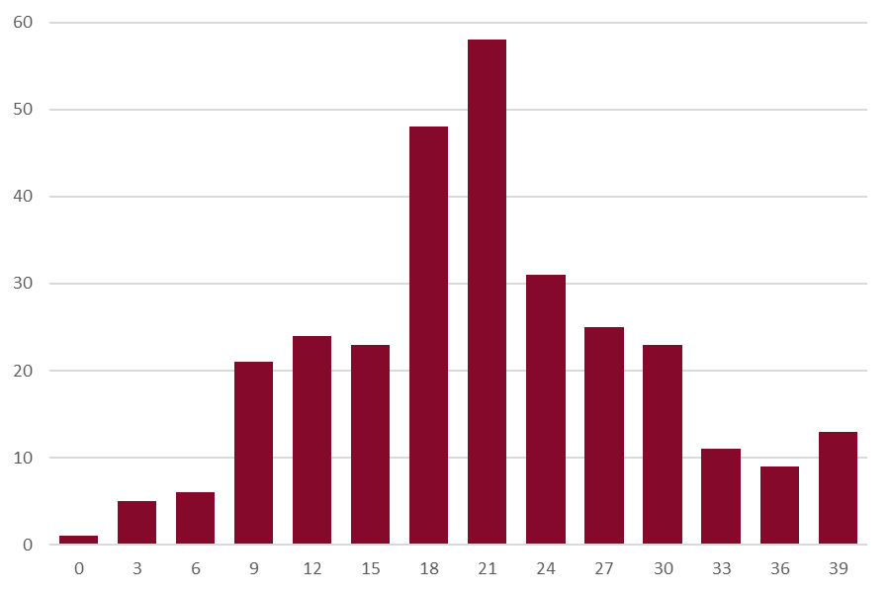
Course Credit Hour Load
per Tenured and Tenure-Track faculty member AY24-25
Number of Faculty
Source: IRDM

Slide 23
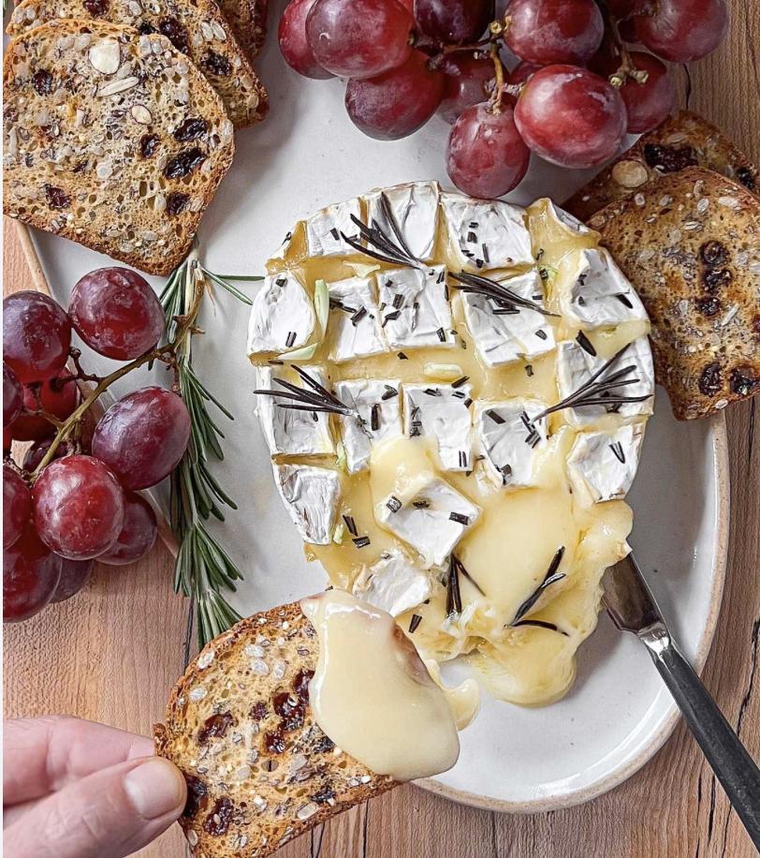
Potential Contribution #1
Raising minimum course enrollment expectations

Slide 24
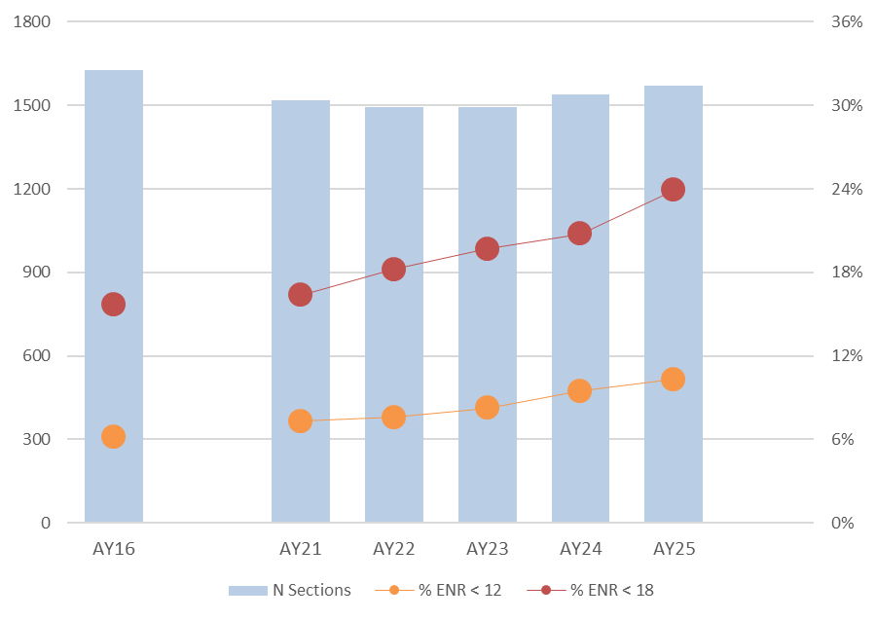
N
%
Number of sections
3 credit hour UG courses with LEC1 | NET1 | WEB1 | HYB1 | MIX1 methods

Slide 25
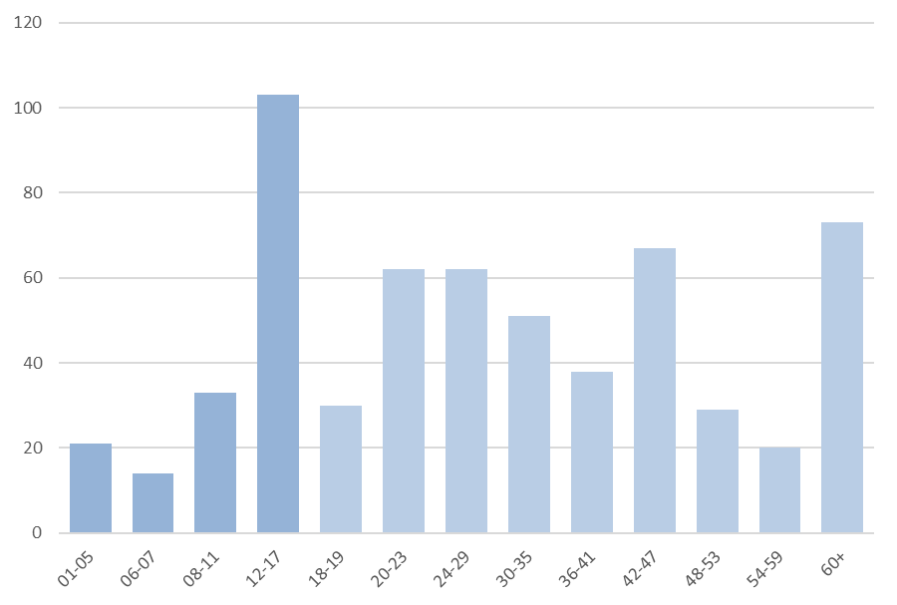
best opportunity
for cost savings
Number of sections
Section enrollment
3 credit hour AY25 UG courses with LEC1 | NET1 | WEB1 | HYB1 | MIX1 methods: Tenured and Tenure Track faculty

Slide 26
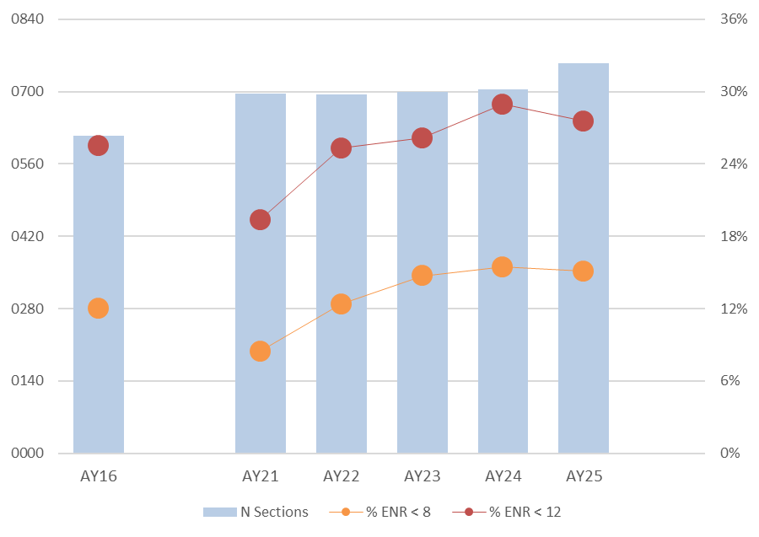
N
%
Note: the number of < 12 sections reached a 10-year high of 208 in AY25, topping the 204 in AY24.
Number of sections
3 credit hour MAS courses with LEC1 | NET1 | WEB1 | HYB1 | MIX1 methods

Slide 27
and this is mainly just looking at 3 credit hour UG courses with LEC1 | NET1 | WEB1 | HYB1 | MIX1 methods
up to
Academic Year reduce | eliminate | replace low enrolled UG
$900k
additionally, if we
reduced | eliminated adjunct taught AY MAS courses with enroll < 12
reduced | eliminated TTT taught Summer UG courses with enroll < 18
reduced | eliminated TTT taught Summer UG courses taught only in summer
reduced | eliminated TTT taught Summer UG courses also taught once in AY
$165k
$227k
$261k
$272k
$1,825,000
we’d potentially free up an additional $900k+

Slide 28
Example

Slide 31

Potential Contribution #2
Larger lecture sections, where appropriate

Slide 32
Enrollment in undergraduate sections
Number of sections
Section enrollment

Slide 33
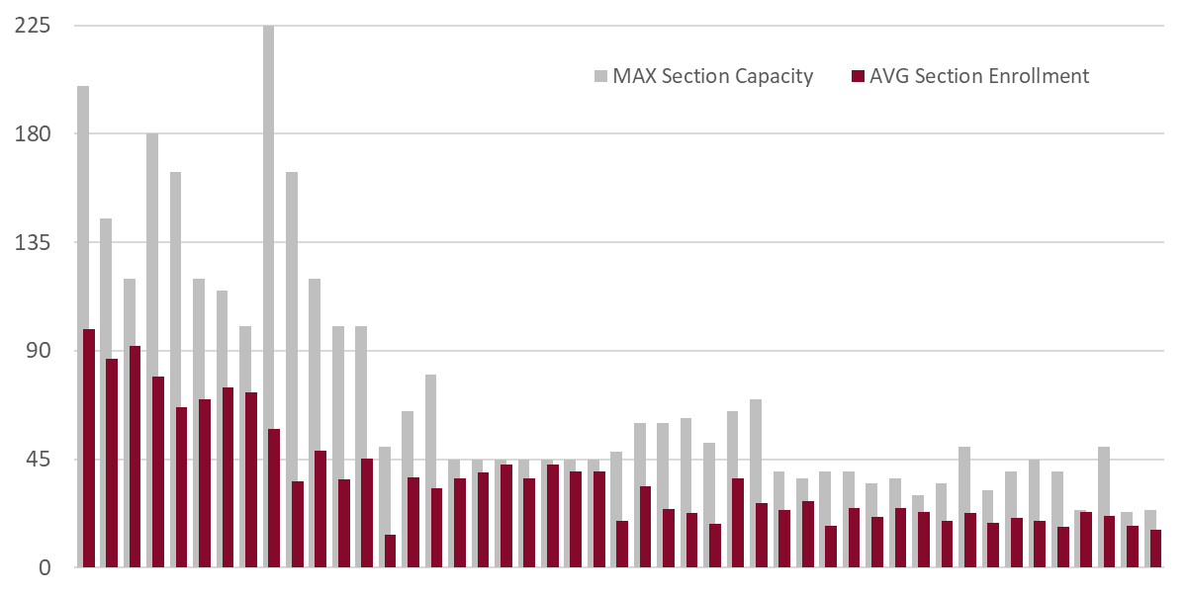
Section Enrollment vs Capacity
for UG 3-hour LEC1, NET1, WEB1, HYB1, and MIX1 sections
each set of bars represents a subject area
Source: IRDM

Slide 34
Example

Slide 37
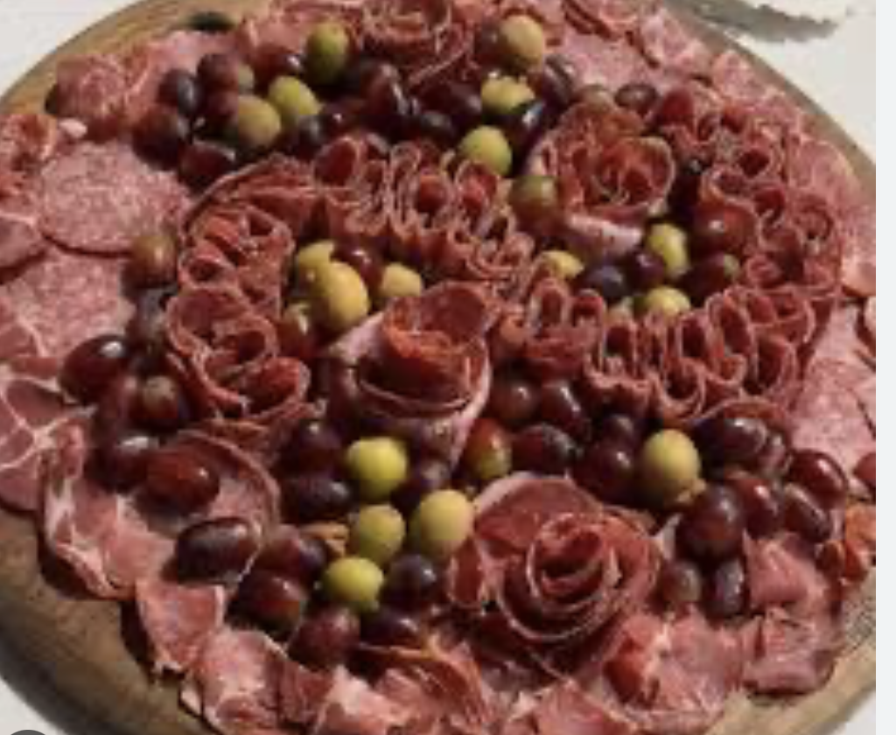
Potential Contribution #3
Cohorting

Slide 39
Other opportunities
Reducing the number of elective offerings in a semester
Rethinking the number of concentrations/emphases in a degree
Others?

Slide 40
Thinking About Workload for Reassigned Time

Slide 41
Workload Policy
Workload consists of teaching, scholarship, and service
Expectation of at least 12 teaching work units per semester per faculty
  Some faculty with little to no expectation for scholarship (e.g., visiting, lecturers, some clinical faculty) may have 15 teaching work units
  Other faculty with higher expectations for research/scholarly activity or service/administrative activities may have reassigned teaching units

Slide 42
Considerations for Reassigned Time
Reassigned time is not “a given”
Reassigned time may be permitted if faculty are performing scholarly activity or service/administration “at a level that warrants the awarding of three to six work units”
“Expected outcomes for the reassigned time will be negotiated between the faculty member and the ACA or Dean.”
Should be fiscally sustainable, appropriate for time and effort, and are accounted for
State reporting must include faculty effort across teaching, scholarship, and service

Slide 43
Considerations for Reassigned Time
Review reassigned time for faculty each semester
  Is the amount of reassigned time appropriate for time and effort?
  Is the faculty providing the ACA/Dean with expected outcomes for reassigned work units?
  Is the faculty being held accountable for meeting the documented expectations?

Slide 44
Workload Considerations for “Code 3” Courses

Slide 45
Overview
The Texas Higher Education Coordinating Board (THECB) requires us to report courses based on the type of instruction.
Code 1: Organized Lecture Course
Code 2: Organized Laboratory, Physical Activity, Clinical Instruction (direct supervision of a group of students)
Code 3: Indirect Supervision of Student Teachers, Interns, Practica and Cooperative Education (where the student also has an on-site direct supervisor or preceptor)

Slide 46
TWU’s Current Work Unit Equivalency
Code 1: Organized Lecture Course
  One semester credit hour (SCH) of course value equals one (1) work unit for organized classes numbered 1000 through 5000; and 1.5 work units for 6000 level courses
  The THECB requires a minimum of one contact hour per SCH (50 minutes of direct instruction)
    3 SCH = the course meets 3 hours/week = 3 work units
    Work units are tied to the amount of time in the classroom
    Faculty spends additional time for course preparation, grading, student meetings/office hours, and student communications (varies by course, support)
Notes:
Work units tied to amount of time in the classroom UNDERSTANDING THAT FACULTY SPEND MORE HOURS PER WEEK THAN JUST THE TEACHING TIME. These include
Additional faculty time varies by course, support available, week-to-week depending on flow of semester, etc.

Slide 47
TWU’s Current Work Unit Equivalency
Code 2: Organized Laboratory/Direct Clinical Instruction
  One lab contact hour equals 2/3 work unit; 3 lab hours per week equals 2 work units
    Work units are based on actual contact hours in the lab, not on the SCH of the course
  Faculty spends additional time for lab preparation, grading, student meetings/office hours, and student communications
Notes:
Faculty prep and grading time may be less intensive than organized lecture courses? Also variable

Slide 48
TWU’s Current Work Unit Equivalency
Code 3: Indirect Supervision of Student Teachers, Interns, Practica, and Cooperative Education (where student also has an on-site direct supervisor or preceptor)
  Total SCH generated divided by six (6) equals work units
  3-SCH practicum course = 0.5 work units per student
  Work units are solely based on SCH and not tied to student contact hours or faculty effort
Notes:
Faculty prep and grading time may be less intensive than organized lecture courses? Also variable

Slide 49
Issues
Programs are permitted to assign SCHs to courses based on program needs, accreditation expectations, degree plan limitations, etc.
Higher SCH for these practicum/internship courses does not necessarily coincide with greater work effort on the part of the faculty
TWU work unit equivalency for 1-SCH through 9-SCH practicum/internship courses:
  1-SCH course = 0.17 work units/student; 18 students = 3 work units
  3-SCH course = 0.5 work units/student; 6 students = 3 work units
  6-SCH course = 1.0 work units/student; 3 students = 3 work units
  9-SCH = 1.5 work units/student; 2 students = 3 work units

Slide 50
Issues
Faculty effort per student in these courses varies widely
ACAs are unsure how best to appropriately and equitably allocate workload for their faculty
  In some 1 SCH courses with high effort, faculty feel overworked
  Many with 3/6/9 SCH and lower effort recognize the over-inflation of work units
Faculty Responsibility | High Effort | Low Effort
Grading | Weekly assignments | End-of-semester paperwork review
Site Visits | Twice per student semester | Only as needed if concerns
Student Communications | Weekly check-ins | Only as needed if concerns

Slide 51
TWU’s Workload Policy
“In principle, assignment of instructional work units for a teaching assignment should accurately indicate the amount of effort required for preparation and instruction, which is not always a simple function of credit hours and class size.”
Refers to additional instructional work units based on various factors, but also applies to appropriate work units in general

Slide 52
Plan
Benchmark with other universities
  TWU’s work unit calculation for Code 2 appears consistent with peer institutions
  For Code 3, TWU appears to provide twice the workload credit compared to other institutions
Revise work units to appropriately reflect faculty effort
  Tiered system?
  Determined with ACA and Dean based on faculty effort
Determine how to document for state reporting

Slide 53
In Preparation for Changes…
Evaluate the faculty effort per student for these courses
Are there factors other than faculty effort that may be relevant to consider?

Slide 54
Case Study 1:
Speech-Language Pathology
  Situation: Has over 200 MS SLP students in Code 3 Practicum any given semester. Following work unit calculation for 3 SCH course would mean 100 work units just to manage practicum (7-8 FTE).
  Previously: 18 work units for faculty managing one distance cohort of 100 students; 6 work units to handle 48 residential students
  The addition of a new distance cohort and restructuring of roles necessitated reevaluation of work units for equity and appropriateness.

Slide 55
Case Study 1:
Speech-Language Pathology
  Faculty Effort:
    Different between distance and residential cohorts; distance more time intensive
    Securing placement sites and verifications, 1 initial meeting per student, 6 quick check-ins, mid-term and final meetings, site visit as needed, weekly hours review but no regular grading. Distance cohort faculty do 7-10 site visits per semester across the state in addition to other effort.
  Current situation following time study by faculty:
    18 work units total
    30-45 students for every 3 work units

Slide 56
Case Study 2:
Physical Therapy
  Situation: Different SCH for clinical education courses based on number of weeks the student is in clinic (1-6 SCH). Averages around 3.5 SCH of Code 3 courses per semester for 108 students. Generates around 63 work units with current calculations (4-5 FTE).
  Faculty effort:
    Securing sites and verifications, grading several assignments, 1 site visit per student
  Currently:
    24 to 30 total work units, depending on the semester.
    Average 12 students for every 3 work units

Slide 57
Discussion questions
Share at least three opportunities for effiencies that you have noted in your fall course schedules.
What potential challenges may arise as you implement these efficiencies?
Do you have new ideas for generating efficiencies that weren’t yet discussed?

Slide 58
Questions? Ideas? Feedback?
Thank you for all that you do for TWU students!

